Slide 1
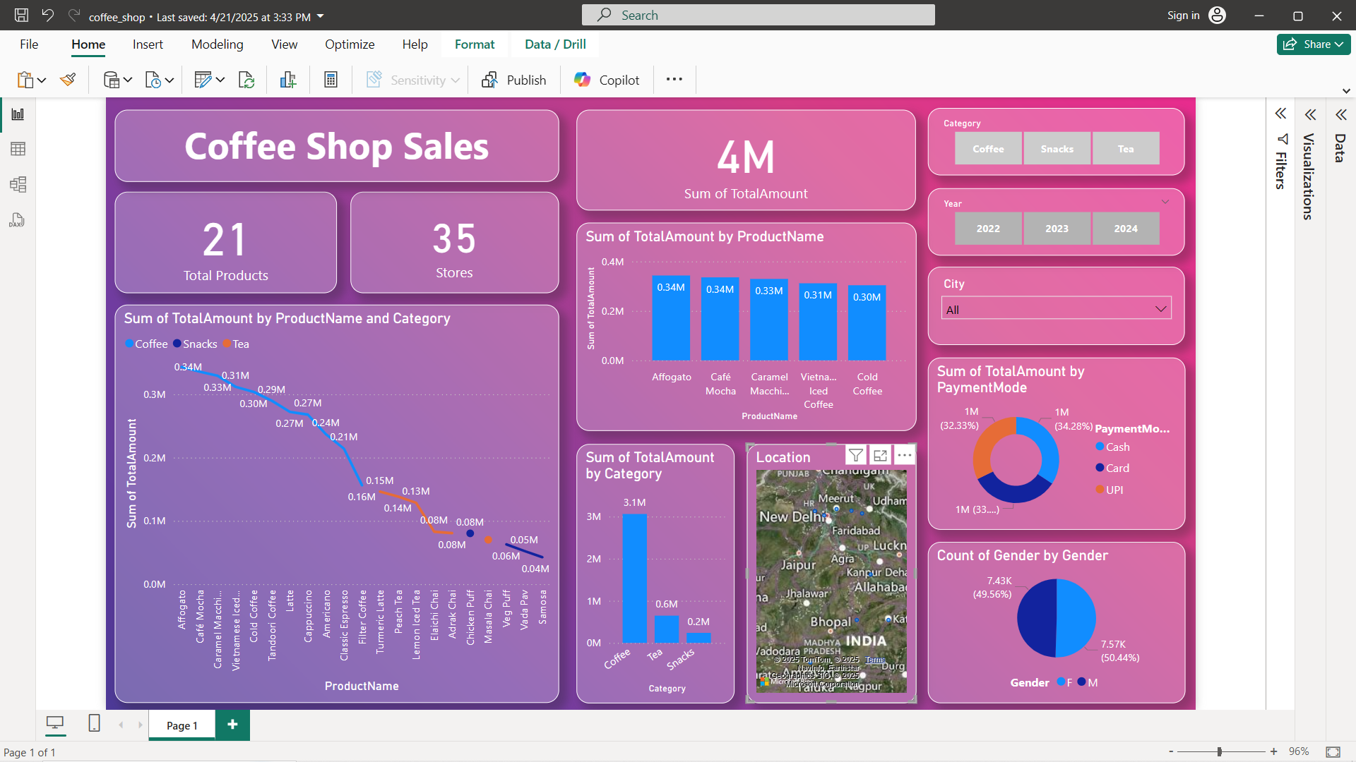
Project Sales Dashboard

Slide 2
Overview
The coffee shop industry thrives on analyzing customer preferences, optimizing product sales, and improving profitability.
In this project, I have developed an interactive Coffee Shop Sales Dashboard using Power BI to visualize total revenue, best-selling products, category performance, store distribution, and customer demographics.
This dashboard empowers stakeholders to track business performance at a glance and identify growth opportunities across products and locations.

Slide 3
Dataset Details
The dataset includes the following fields:
Product Name – Name of the coffee, tea, or snack item
Category – Coffee, Tea, or Snacks
Store – Number of store locations
Total Amount – Sales revenue
Payment Mode – Cash, Card, UPI
City – Location of stores
Gender – Customer demographics
Year – Transaction year (2022, 2023, 2024)

Slide 4
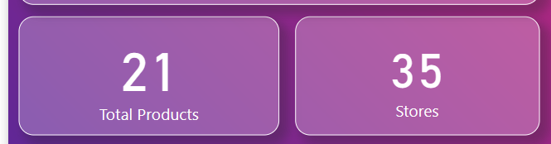

KPI Tiles
Charts: Single Value Cards
Fields Used:
Total Products → 21
Stores → 35
Total Sale → 4M
Purpose: Instantly show high-level business metrics at a glance, helping stakeholders quickly assess total scale and revenue.

Slide 5
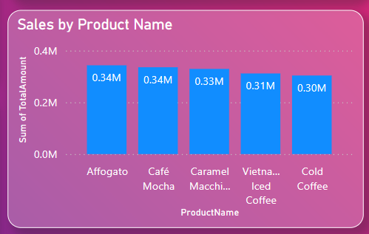
Sales by Product Name (Bar Chart)
Chart Type: Clustered Column Chart.
Fields Used:
Axis: ProductName
Values: SUM(TotalAmount)
Purpose: Highlight top-performing products. Quickly identify best-sellers like Affogato and Café Mocha.

Slide 6
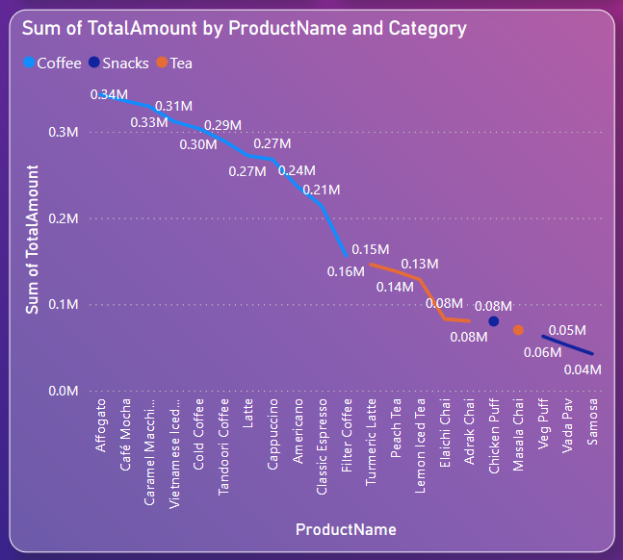
Sales by Product Name and Category
Chart Type: Line and Dot Combination Chart
Fields Used:
Axis: ProductName
Values: SUM(TotalAmount)
Legend: Category
Purpose: Show how individual products perform across categories (Coffee, Snacks, Tea) for a deeper comparative analysis.

Slide 7
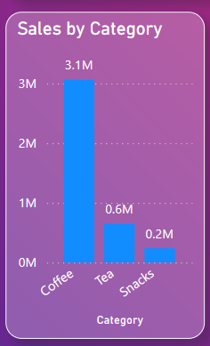
Sales by Category
Chart Type: Vertical Bar Chart
Fields Used:
Axis: Category
Values: SUM(TotalAmount)
Purpose: Understand overall revenue contribution of Coffee, Tea, and Snacks to prioritize inventory and marketing strategies.

Slide 8
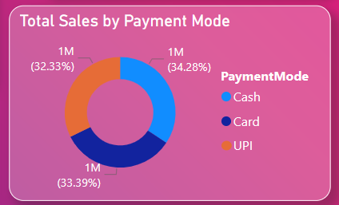
Sales by Payment Mode
Chart Type: Donut Chart
Fields Used:
Legend: PaymentMode
Values: SUM(TotalAmount)
Purpose: Visualize payment behavior among customers and balance between Cash, Card, and UPI transactions.

Slide 9
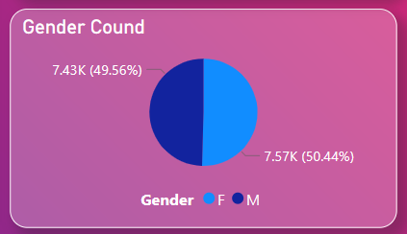
Gender Distribution
Chart Type: Pie Chart
Fields Used:
Legend: Gender
Values: Count of Gender
Purpose: Show customer gender distribution for demographic insights and marketing segmentation.

Slide 10
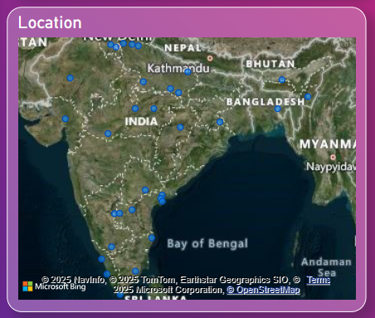
Store Locations
Chart Type: Filled Map
Fields Used:
Location: City
Size: SUM(TotalAmount)
Purpose: Geographical view of sales performance to recognize high-performing cities like New Delhi, Chandigarh, etc.

Slide 11
Key Insights
Coffee dominates total sales revenue.
Affogato and Café Mocha are best-sellers.
Payment methods are evenly used.
New Delhi is the top sales location.
Gender distribution is nearly balanced

Slide 12
Conclusion
The Power BI Coffee Shop Sales Dashboard provides a dynamic and interactive view of business performance.
It supports strategic decision-making by offering clear insights into product trends, geographic performance, and customer demographics.

